Slide 1
Noor Mustafa Rajpar BSCs IBA
How To Pull And Run Node.js Image in Docker !

Slide 2
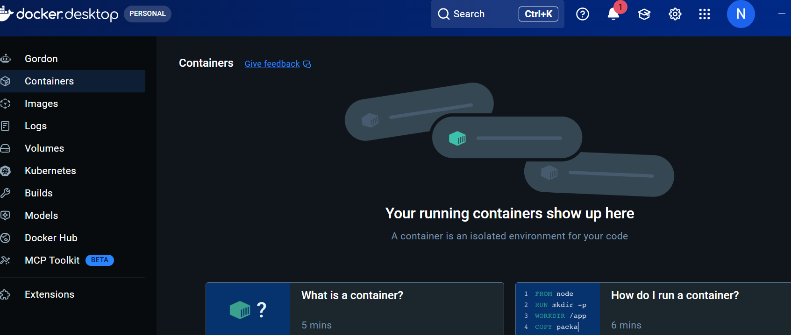
Step1:Open Docker Desktop

Slide 3
Step2:Click on Search Bar

Slide 4
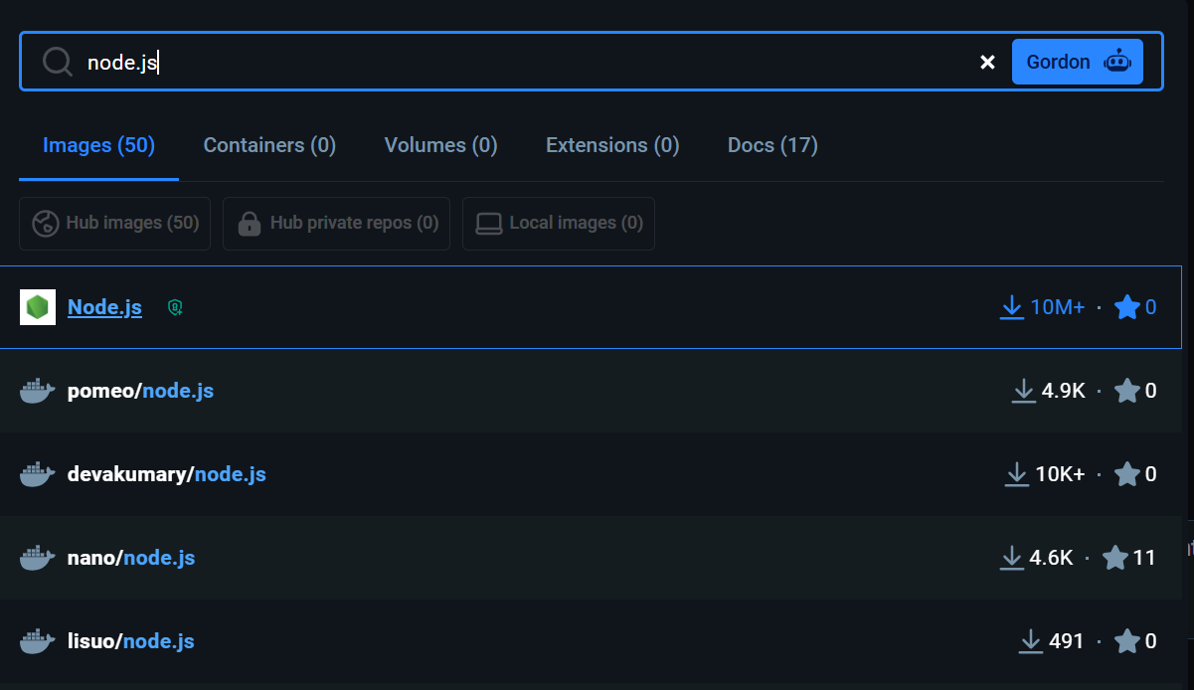
Step3: Write Node.js

Slide 5
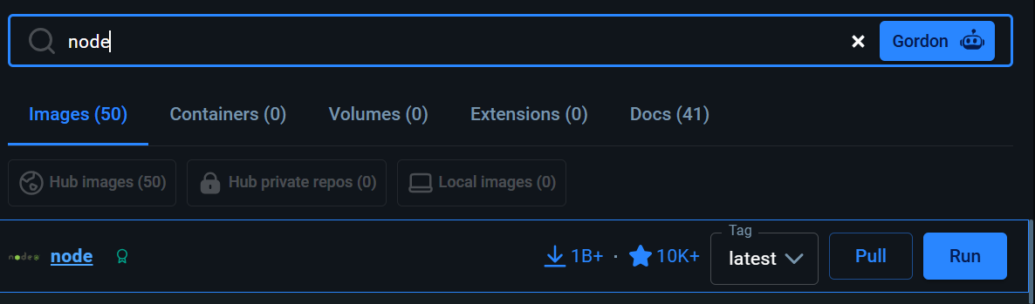
Step3: Click on Pull !

Slide 6
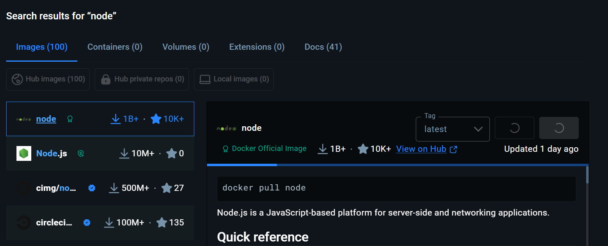
Step4: You can see Command is also visible for run!

Slide 7
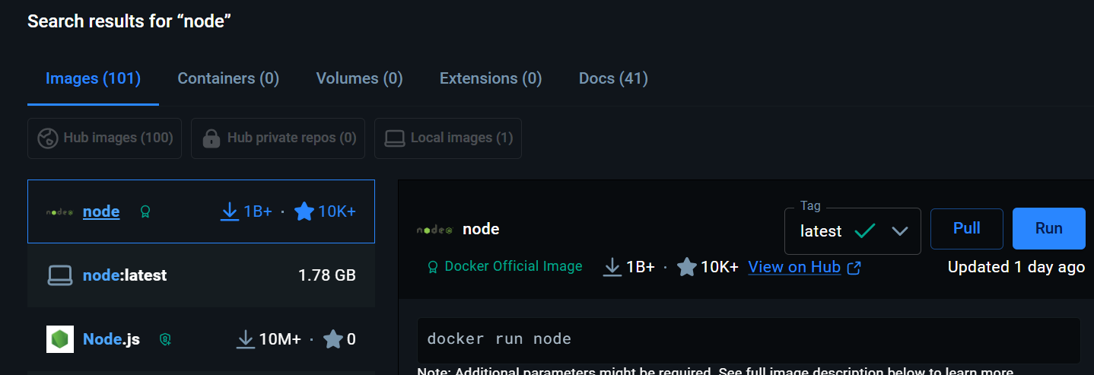
Step5:Dowloaded!

Slide 8
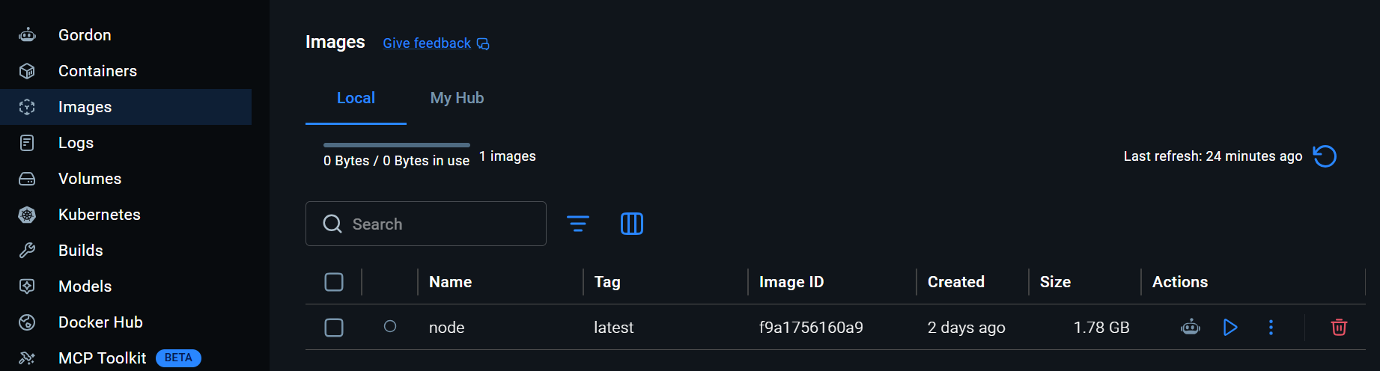
Step6:we can check on images that file has been downloaded.

Slide 9

Step7:Run The Image.
Note: When we run an image, it becomes a container. This means it is deployed into a containerized environment.
Note: Now Run That image . There are mainly two ways to run docker image.
1: click on Run icon.
it starts running and showing into the containers.

Slide 10
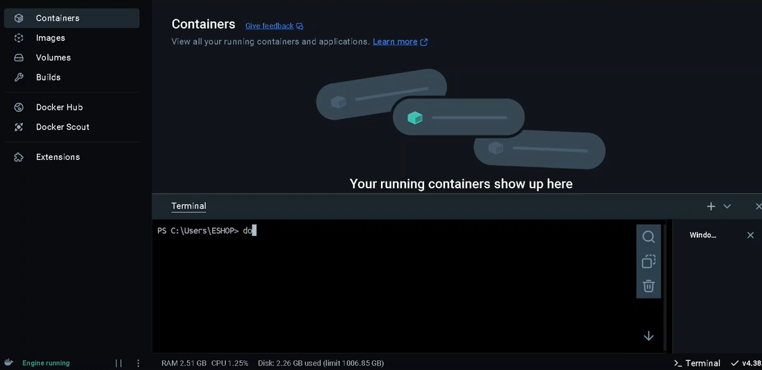
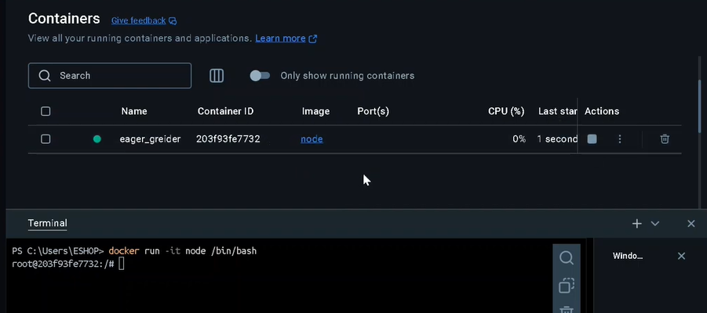
Step8:2nd way to Run image using Terminal.

Slide 11
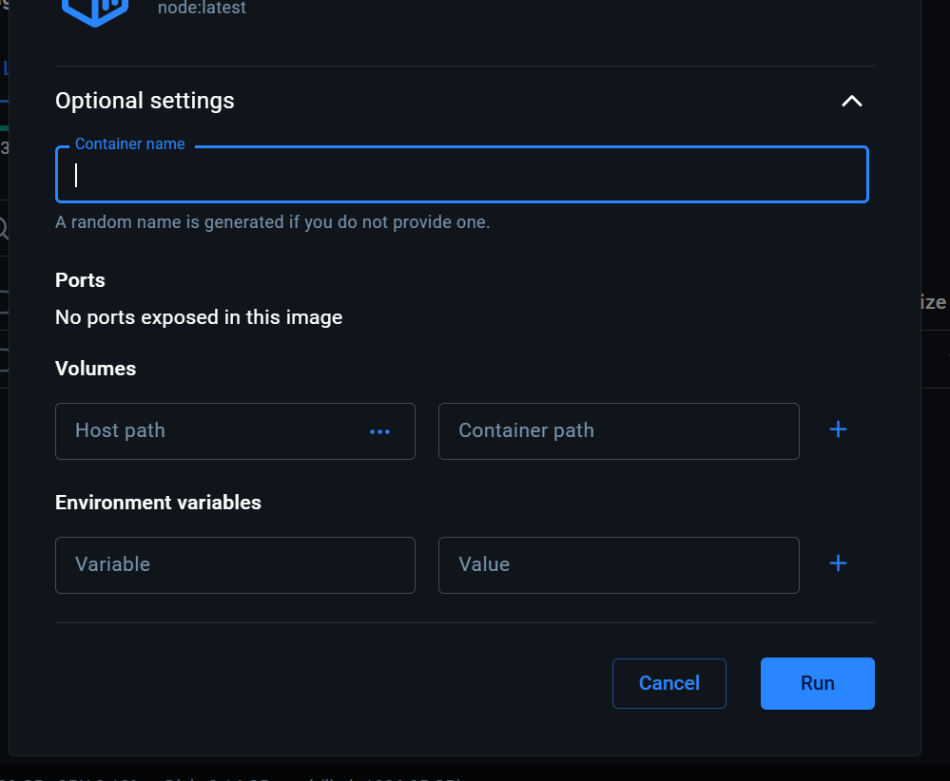
Step9: Custom Setting

Slide 12
Step9: Custom Setting
1. Container name
What it is: The custom name you want to give this specific running container instance.
What to do: You can leave it blank. If you don't type anything, Dockers will automatically generate a random, fun name for you (like determined_feynman or suspicious_shockley).
2. Ports
What it is: This maps a port on your local computer (Host) to a port inside the container so you can access applications (like a web server) via your browser.
What to do: It currently says "No ports exposed in this image". Since you are running a base Node.js image without a specified port script built into the Dockerfile, you don't need to change anything here.

Slide 13
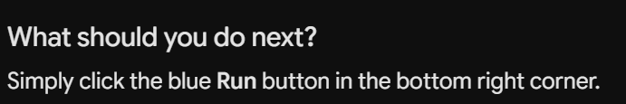
Step9: Custom Setting
3. Volumes
What it is: This links a folder on your actual computer (Host path) to a folder inside the Docker container (Container path). It allows your code changes on your computer to instantly sync inside the container without rebuilding it.
What to do: Leave it blank for now unless you are specifically trying to mount your local project directory into the container.
4. Environment variables
What it is: Configuration settings passed into the container at runtime (like NODE_ENV = production or API keys).
What to do: Leave blank unless your Node application requires specific configuration keys to run.

Slide 14
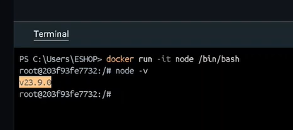
Step10: run The Command
Note: When you check your host system, it will show the version you have downloaded locally. However, when you check inside the Docker container, the Node version will be completely different!

Slide 15
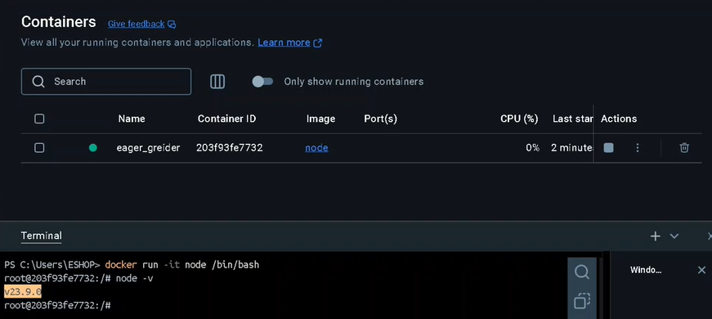
Step10: So This Is How we can pull and push image.

Slide 16
Thank You !

